Slide 1
Façade Design Pattern
Presented by Elvis Tran

Slide 2
Overview
What is a Façade Design Pattern
When to use a Façade Design Pattern
UML Diagram of a simple Façade
Example Code of a Façade
Complementary Design Patterns
References & Resources Used
Q&A

Slide 3
What is a Façade
Classic Definition: An outward appearance that is maintained to conceal a less pleasant or credible appearance
GoF/Textbook Definition: Provide a unified interface to a set of interfaces in a subsystem. Façade defines a higher-level interface that makes the subsystem easier to use
Laymen terms: This design pattern is meant to hide the ‘ugly’ algorithms and subsystems that are used to do a specific task from the client

Slide 4
When to use a Façade Design Pattern?
For projects that will incorporate or utilize multiple different subsystems
For large scale projects where team-members or teams will be assigned a functionality or specific part of the system to develop

Slide 5
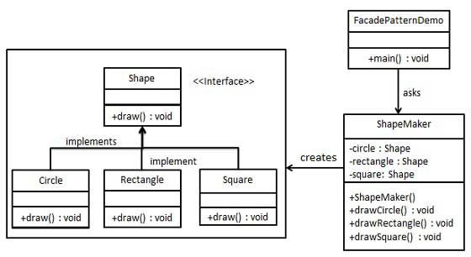
UML Diagram
http://www.tutorialspoint.com/design_pattern/facade_pattern.htm

Slide 6
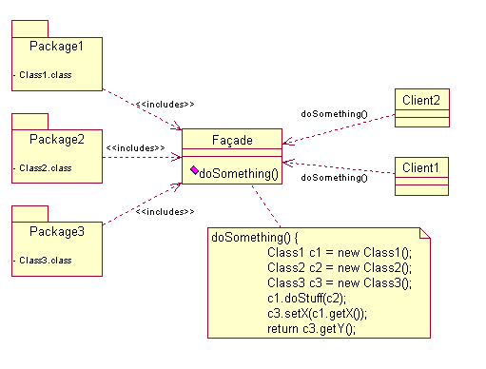
UML Diagram
http://www.dineshonjava.com/p/facade-design-pattern.html#.Vw-81zArKCp

Slide 7
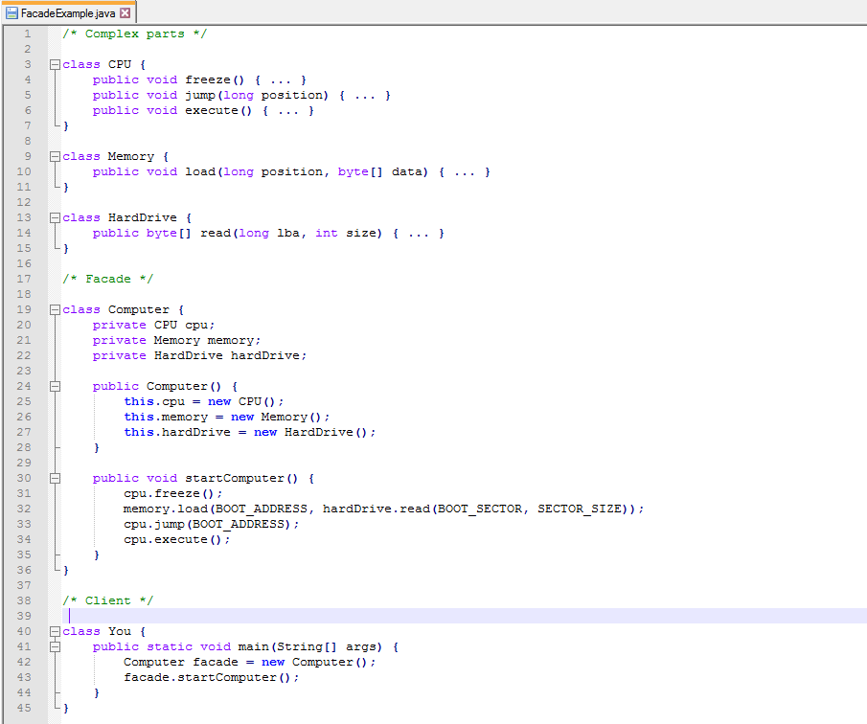
Code Example

Slide 8
Complimentary Designs Patterns
Abstract Factory – Can be utilized to create an interface for making the correct subsystem objects depending on the kind of subsystem required
Singleton – You generally only need one Façade object for all clients
Mediator – Is similar to Façade in its own way but can be useful for inter-communication between subsystems

Slide 9
References and Resources Used
http://www.tutorialspoint.com/design_pattern/facade_pattern.htm
http://www.dotnetexamples.com/2013/07/facade-design-pattern.html
http://www.dineshonjava.com/p/facade-design-pattern.html#.Vw_qlTArKCp
“Design Patterns: Elements of Reusable Object-Oriented Software” by Erich Gamma, Ralph Johnson, Richard Helm, John Vlissides

Slide 10
Q&A
Ask away!

